Slide 1
Effective Resume Writing

Slide 2

Resumes are a summary of your academics and work history

Slide 3

Resumes
Resumes are a true depiction of
  Personality
  Background
  Capabilities
  Accomplishments
  How Organized You Are
  Your sense of Quality

Slide 4

What resumes do for you
First impressions
Organize your thoughts
Highlight relevant facts about you, your education and experience
Positions you in the mind of the employer, creating value
  Branding!
Be a basis for the interviewer to justify your hiring

Slide 5
Why is a resume important
Competition is fierce!
Resume needs to be Attention Grabbing
First impressions matter!
Hiring managers using spend 15-20 seconds per resume
Spend time on preparing a targeted, effective and error free document.

Slide 6

Resume essentials
Profile/Personal Details
Educational Qualifications
Professional Experience
Technical Qualifications
Core Competencies
Skills (areas of expertise)
Achievements & Rewards
References

Slide 7

Resume tips
Write the resume with a target in mind (know your audience)
Analyze the job ads and compose your resume to meet the requirements
  Hit Key Words
Short & Detailed at the same time
No white space
Show promotability & loyalty
Highlight recent achievements and jobs first

Slide 8
Grammar & Typing Mistakes
No excuses for typing mistakes, grammatical errors and spelling.
  We have the technology to fix this!!
Use Action verbs to demonstrate your skills
Organized | Directed | Planned
Created | Assisted | Initiated
Analyzed | Developed | Managed

Slide 9

EMPLOYMENT HISTORY
No need to include all your bosses/managers – only 3 references at the end
Ensure there are no gaps in employment history without explanation

Slide 10
formatting
If providing a paper copy – think about quality of paper and printer
Good formatting can’t get you the job, but bad formatting can prevent it!
If sending a resume by email, use PDF format
  It looks better and shows you take the extra step!
Avoid photocopied or scanned resumes
Chose a professional font style & stay consistent
  NO COMIC SANS

Slide 11
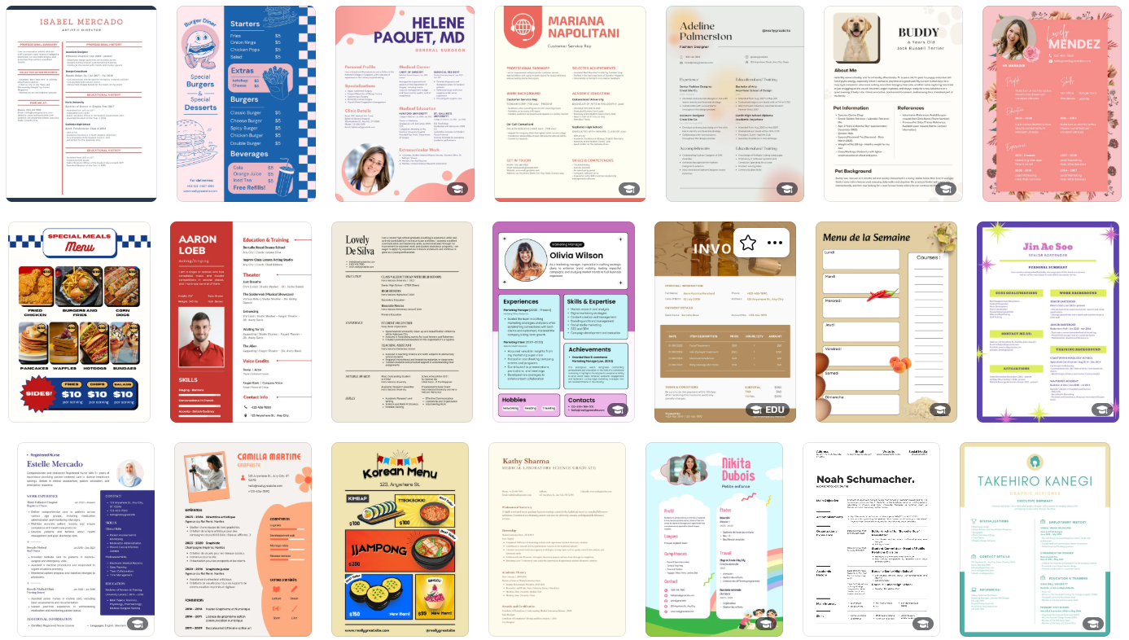
Using SOFTWARE TO HELP YOUR RESUME
Canva
  Lots of templates to use!
  Have your resume stand out
AI is here to help!
  Use co-pilot or Chat GPT to edit and change formatting
  Let’s look at an example

