Slide 1


Slide 2
Use a Professional Email Address
Don’t fall into the trap of creating a silly or overly personal email address like gamergirl96@example.com or 2fierce2fail@example.com.
The key to a professional email address is keeping it simple. For example, you can use the format johndoe@example.com or jane.doe@example.com. Don’t try to personalize your email address by adding in numbers or a creative slogan

Slide 3

Why would a high school student need to send a professional email?
COOP Placement/Job market
College/University Application
Teachers/References

Slide 4
Consider the following scenarios:
It’s after school hours and you are checking your grades. You notice that your teacher has incorrectly inputted the grade for one of your assignments, and your grade is now lower than it should be. You need get in touch with your teacher right away so you can plan an in-person meeting to talk about it the following day.
You need to make an appointment with your principal or counselor right away.
You are seeking a professional job or a COOP placement from an employer whom you have never met before.
You wish to contact an admissions officer or professor from a college or university you are applying to

Slide 5

Use a Simple, Clear Subject line
The subject line is meant to summarize the content of the email in a few words.
GOOD: Class Name 101: First Name Last Name Grade Change Request
BAD: FIX MY GRADE NOW!!!!!!
GOOD: Request for meeting on campus
BAD: You want to meet THIS student
GOOD: Job openings at [Business Name]
BAD: PLEASE hire me. I’m a very capable student.

Slide 6
Use Professional Salutations
This looks something like “Dear Mr. Lovett, and it’s a must for professional emails.
If you don’t want to use the word “Dear”, you can use another greeting as long as it still sounds professional. For example, you could say “Hello” or “Good morning/afternoon” but maybe not “Yo” or “Howdy”.
If you don’t happen to know the name of the person you are emailing you should still use a professional salutation. The most common salutation in this instance is, “To Whom It May Concern.”

Slide 7
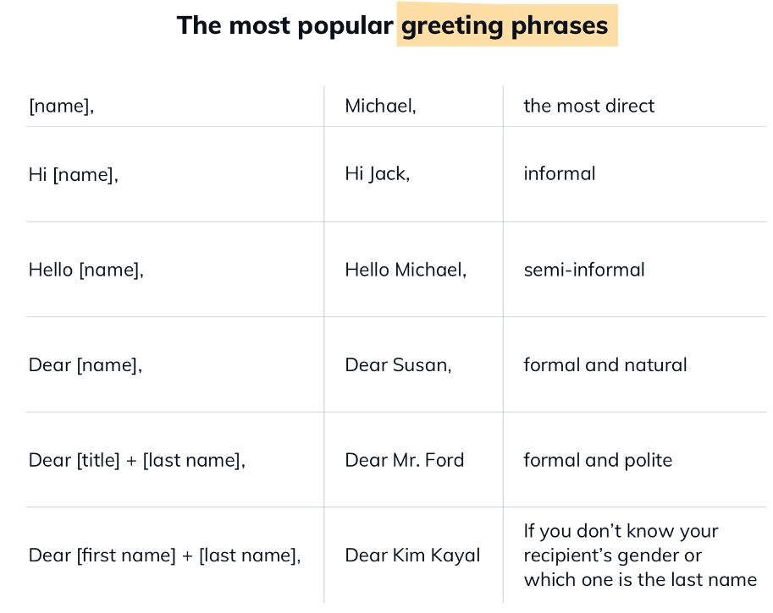

Slide 8
Introduce Yourself
You should use the first few sentences of your email to introduce yourself and explain to the recipient who you are.
BAD: Hi there. My name is Pete Lovett, and I want a job at your company.
GOOD: I hope this email finds you well. My name is Peter Lovett, and I am a current Grade 12 student at Brantford Collegiate Institute & VS. I am emailing to see if there are any job openings (COOP placements) for high school students at your company.

Slide 9
Be Concise
When crafting your email, say what you need to say and get out quickly.
The key is making sure the writing in the body of your email is brief and to-the-point.
As a general rule, a few paragraphs of text in your email is more than enough. If you truly can’t say everything that you need to say in those few words, it may be worth meeting this adult in person instead to have a full conversation.

Slide 10
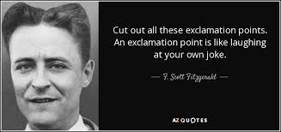
Use Exclamation Points Sparingly
Exclamation points, as a rule, are considered a tad unprofessional
If you decide to put an exclamation point at the end of a sentence, only put one exclamation point—don’t put multiple to make it sound more exciting

Slide 11
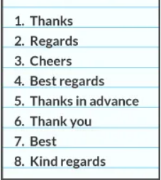
Add a Conclusion to Your Email
Always thank the recipient for taking the time to read it.
If you are trying to schedule a meeting or further contact with the person, you can say that you look forward to speaking to them again.
Sign your name. Use another professional salutation like “Sincerely” or “Best”. Again, keep the salutation professional. Signing your name with something cute like “see you later, alligator” may not be well received.
When you sign your name at the end, you can either use your full name or input a professional signature block. This includes your full name, high school and year of graduation (if you want), and contact information such as email address and phone number.

Slide 12
General Email Tips
BCC when you need to be discreet or protect the privacy and personal information of recipients
CC only the individuals who need to receive your reply
Reply-All only when everyone in the email thread needs to see your response

Slide 13

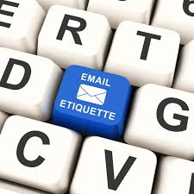
Email Activity

